Slide 1

Support for self care, and e-learning for pharmacy professionals
Rob Darracott
Self Care Forum Board

Slide 2
1. The Self Care Forum

Slide 3
Self Care Forum
Established 2011 as a coalition of nurses, patient groups, pharmacists, doctors, academics, public health and the NHS
Passionate about improving people’s ability to look after their own health.
Mission:
Further the reach of self care and embed it into everyday life, making self care a life long habit and culture for everyone.

Slide 4
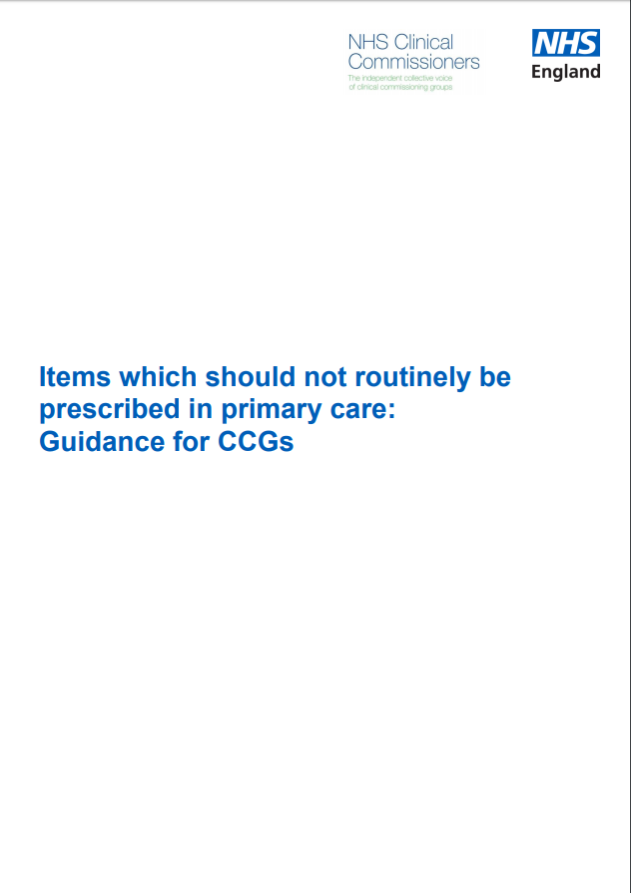

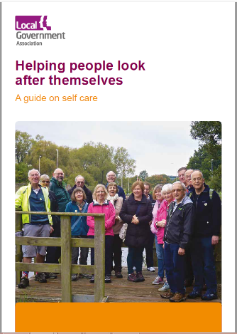


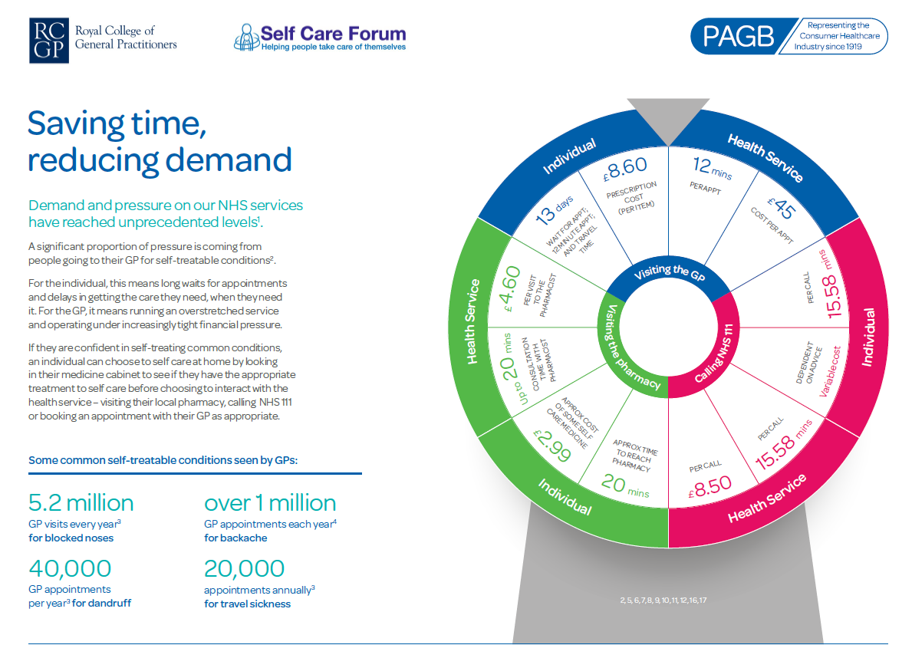
Self Care Forum
Produces and provide resources and support for people-facing organisations (such as pharmacies, surgeries, councils etc)
Organise the annual awareness campaign Self Care Week
Organise the Annual Self Care Conference
Influence policy
Lobby on issues supportive of the mission:
  Example: campaign for health education to be on the National Curriculum

Slide 5

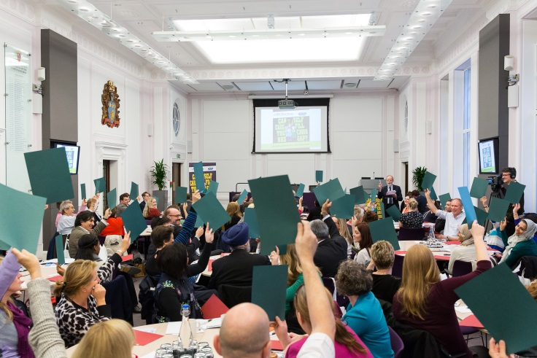
Key activities
Self Care Week
Self Care Conference
Notes:
Stakeholder engagement programme

Slide 6
Self Care Week 2017: successes
78 CCGs reached a population of 22m, more than a third of the people in England
The majority of local Self Care Week activity focused on self treatment of minor concerns
Health Minister, Stephen Brine MP announced it in a press release
#selfcareweek trended on twitter on 13 Nov
Sir Kevin Barron MP
Highlighted the importance in Parliament via PQs and an Early Day Motion
More than 300 organisations took part in Self Care Week
A twitterchat generated 298 tweets
Notes:
Egs of orgs participating

Slide 7
Participating Organisations
2011
2012
2013
2014
2015
2016
2017
Less than 50
50
100
100
160
200
300

Slide 8
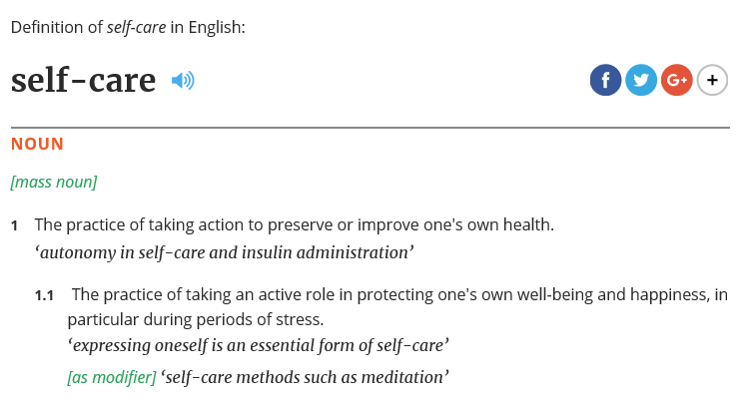
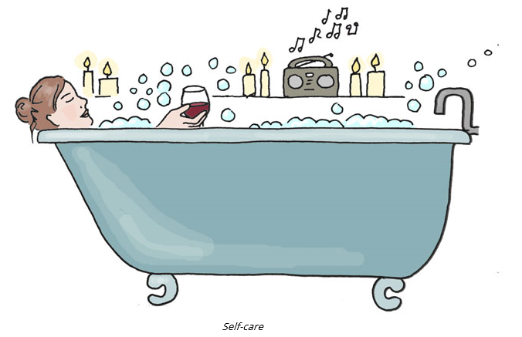

It’s in the Oxford Dictionary!

Slide 9
What next?
Business Plan
Expand activities
Collaborations
Find funding!

Slide 10
2. Why now?

Slide 11
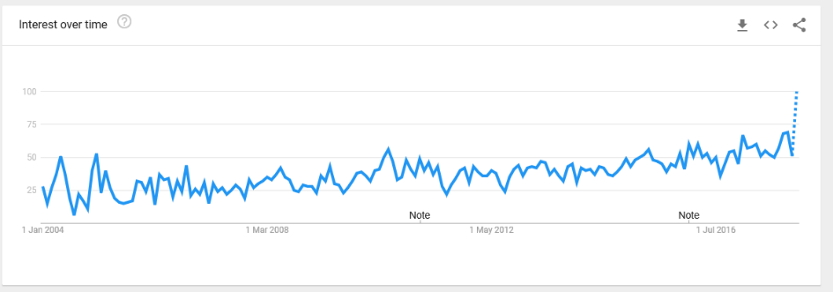
Everybody’s Googling it

Slide 12
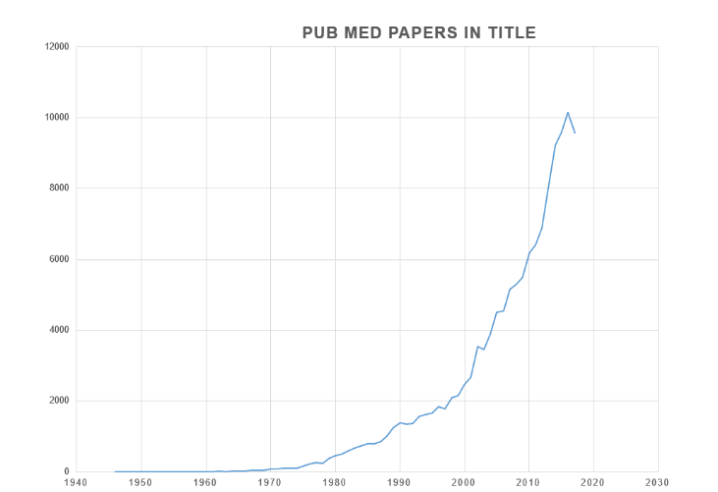
Academics have recognised it
2017: Self Care Academic Research Unit, Imperial

Slide 13
Why change what we are doing?
It infantilises informed patients
It encourages poor medicine
Prescribing medication encourages dependence
It’s unnecessary
It’s costly
appointments
attendances at A & E

Slide 14
Why is self care good for people?
  Builds confidence and resilience
  Gives people control over their own health
  Helps people live longer, healthily
  Reduces people’s time spent in health-care settings
  Reduces time off work
  Increases people’s confidence to have a shared decision making conversation with health professionals
Self Care does not mean no care

Slide 15
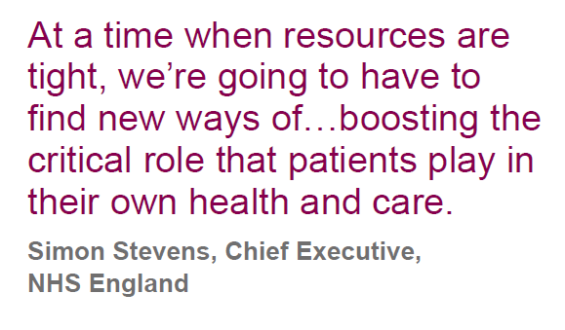
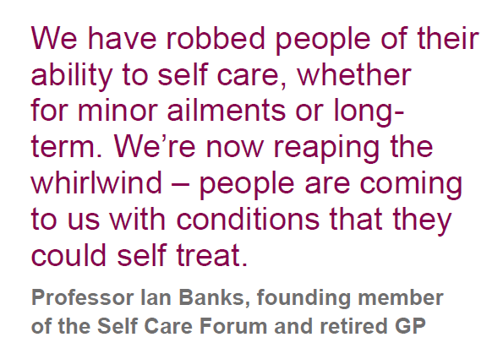
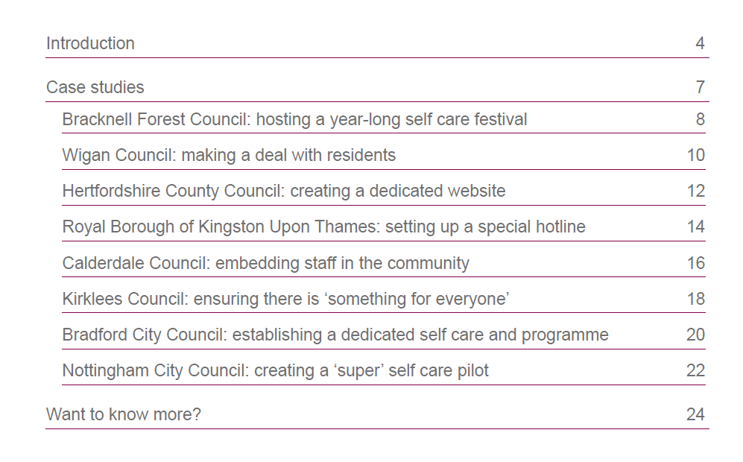

Slide 16
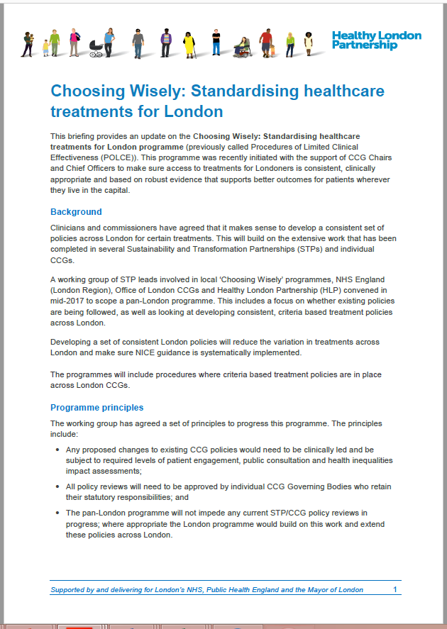
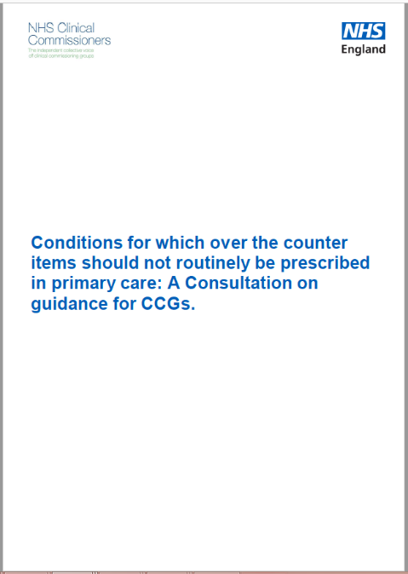
OTC Consultations

Slide 17
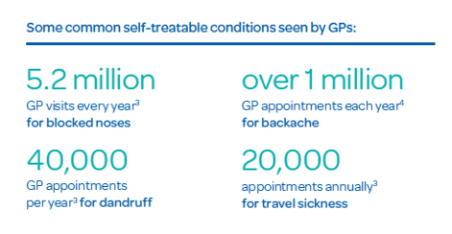
2017 Self Care Nation, PAGB

Slide 18
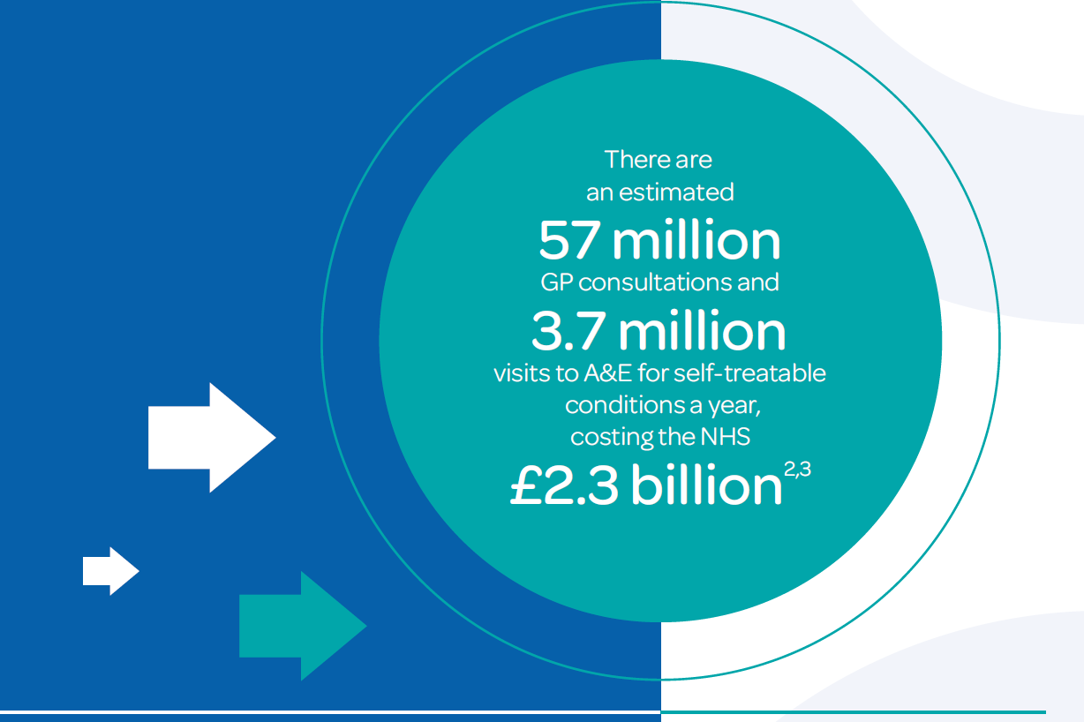
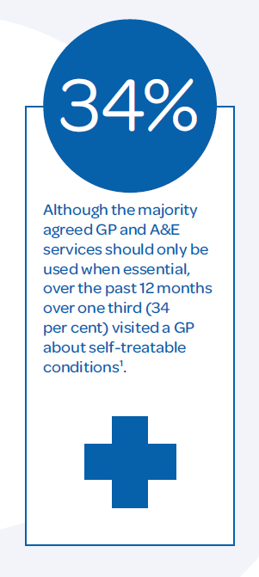
2017 Self Care Nation, PAGB

Slide 19
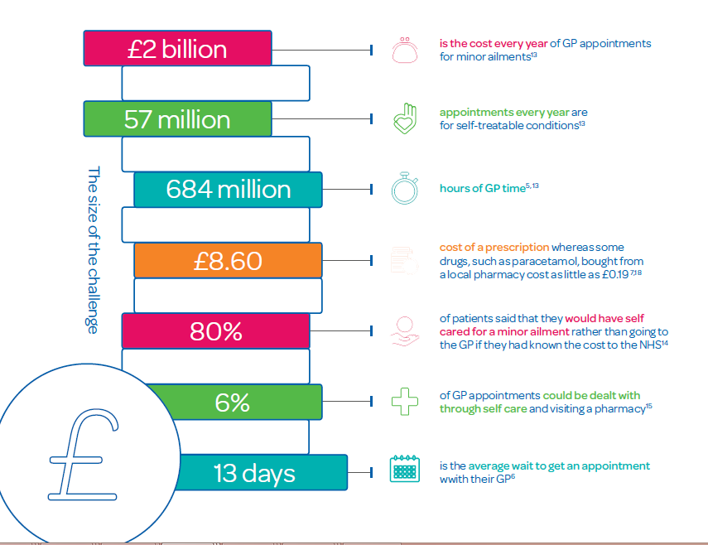


Slide 20
3. GP consultations for home treatable conditions?

Slide 21
Why do people attend?
Because they feel unwell
Because they are worried they are developing something worse
Because that’s what they did last time
Because someone else says they should
For reassurance
For succour
For treatment if appropriate

Slide 22
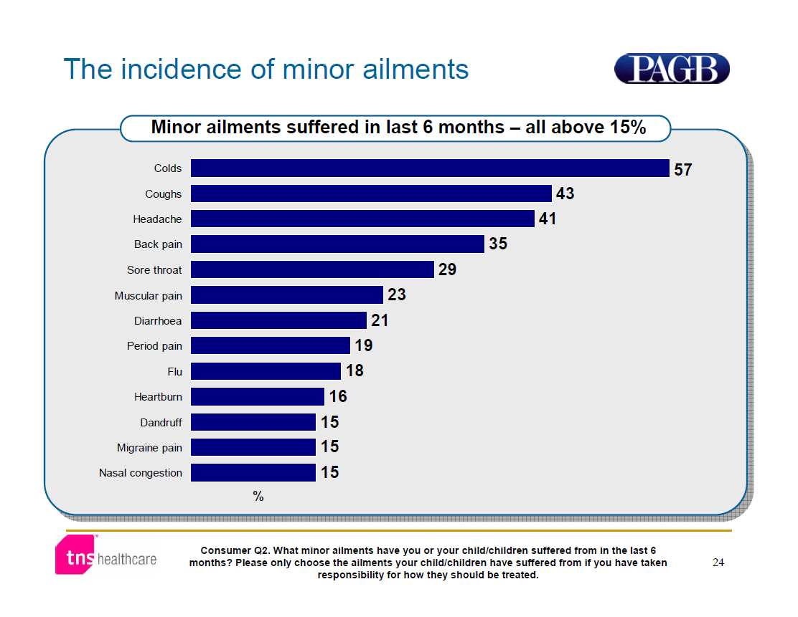

Slide 23
Symptoms experienced over a 2 week period
75% had 1-22 symptoms
40m in England
 | %
Feeling tired/run down | 41
Headaches | 38
Joint pain | 31
Back pain | 30
Difficulty sleeping | 28
Sore throat | 19
Nervousness/anxiety | 18
Indigestion/heartburn | 18
Cough | 18
Cold or flu symptoms | 17
Feeling depressed | 16
Stomach/abdominal pain | 15
Diarrhoea | 12
Nausea/feeling sick | 11
Constipation | 9
Dizziness | 9
Shortness of breath | 8
Wheezy chest | 7
Loss of appetite | 5
Chest pain | 5
Vomiting | 4
Blood in stool | 2
Unintentional weight loss | 2
Fainting | 1
Coughing up blood | 0
Ascertaining the size of the
symptom iceberg in a UK-wide
community-based survey
Philip C Hannaford, Anne McAteer and Alison M Elliott
British Journal of General Practice, January 2011

Slide 24


Nurse
NHS Direct
Pharmacist
GP
Symptom Iceberg
Complementary Medicine
Talk to friend
OTC Medicine
Seek
info
Do
Nothing
Only 8% will visit their GP
75% of patients will have a symptom of some kind within any 2 week period

Slide 25
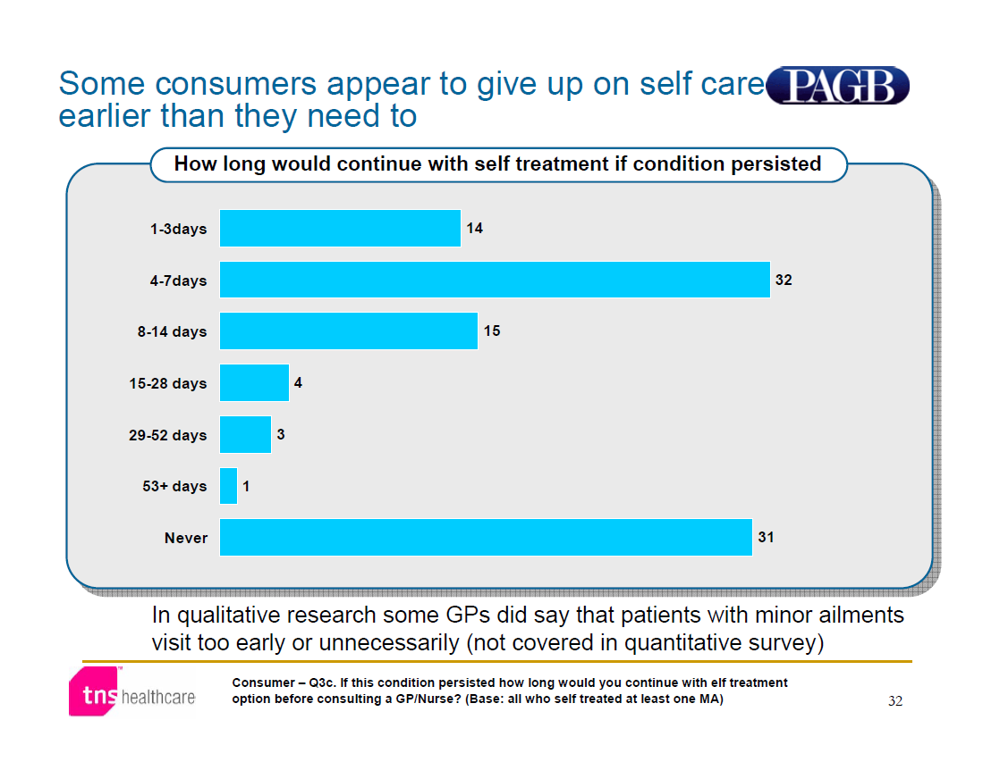

Slide 26
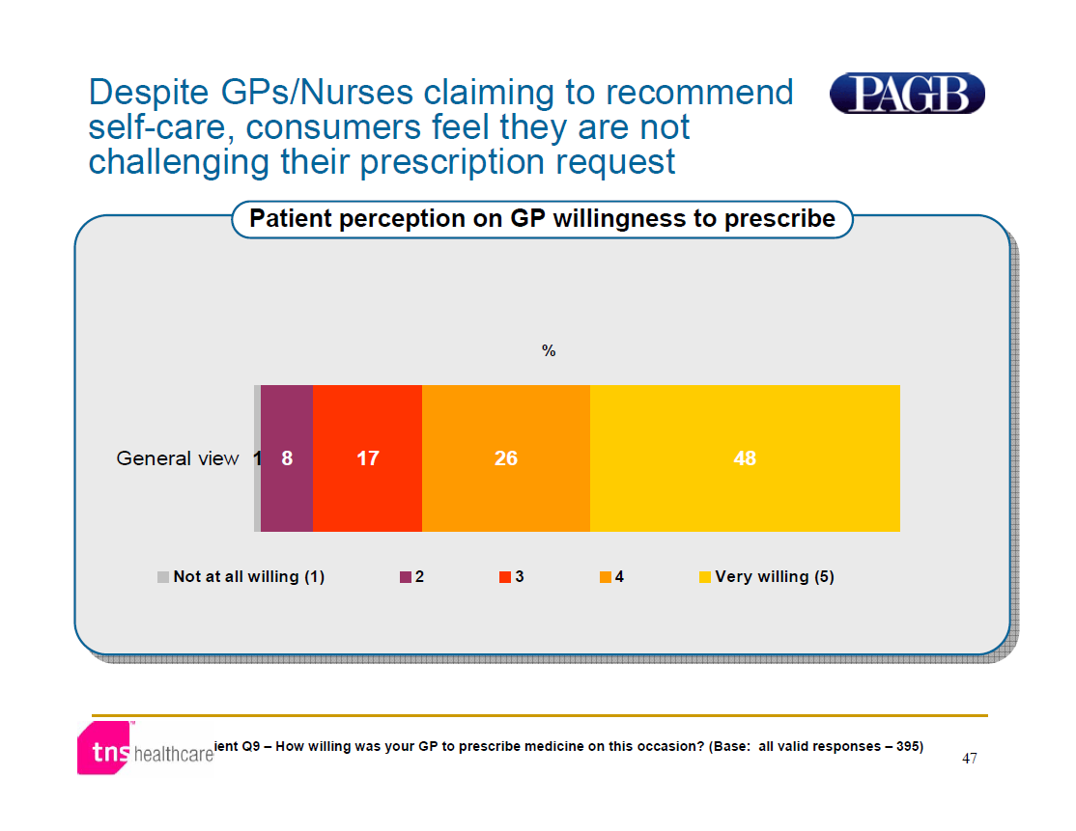

Slide 27
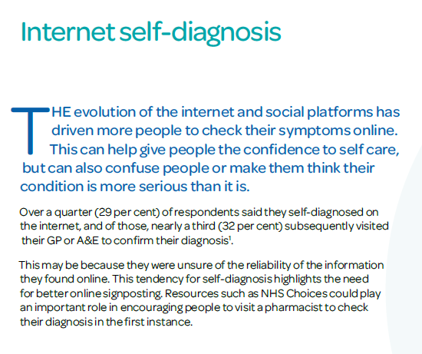
2017 Self Care Nation

Slide 28
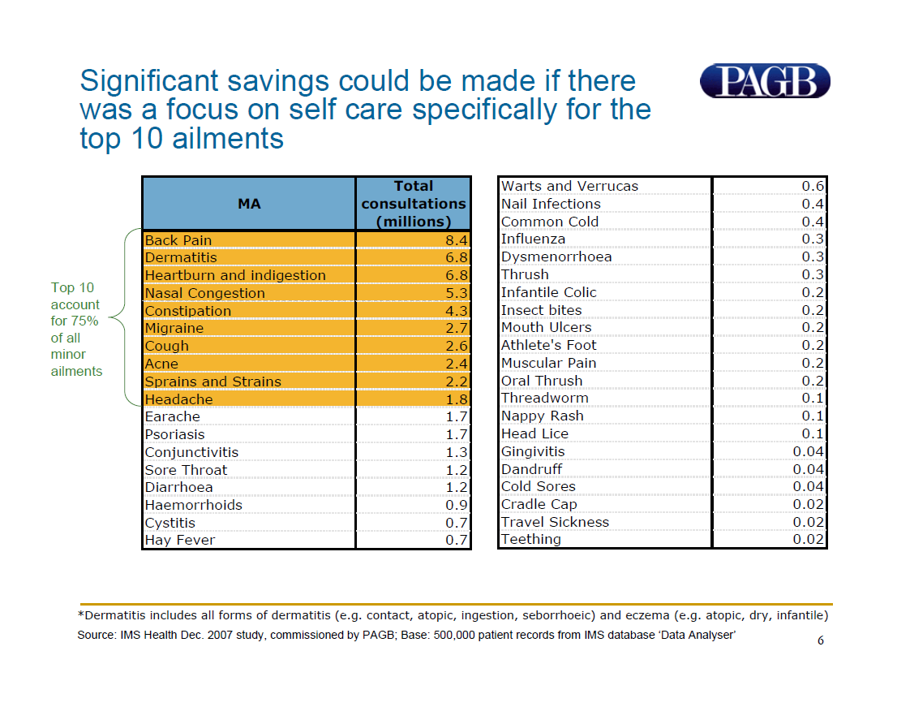

Slide 29
4. Where do we start?

Slide 30
GP Concerns
New conversations needed
Do we expose ourselves to medicolegal risk?
Patients expect a prescription
Don’t like to turn patients away
Limited time to explain abut conditions
Limited knowledge of what medication to prescribe
Where are the ‘tools’

Slide 31
Self Care Aware Consultation
What have you already tried?
How long have you tried this?
What were you trying to achieve by doing/taking this?
Has it worked and how?
Have you stopped doing what you tried – and why?
What could you do next time?

Slide 32
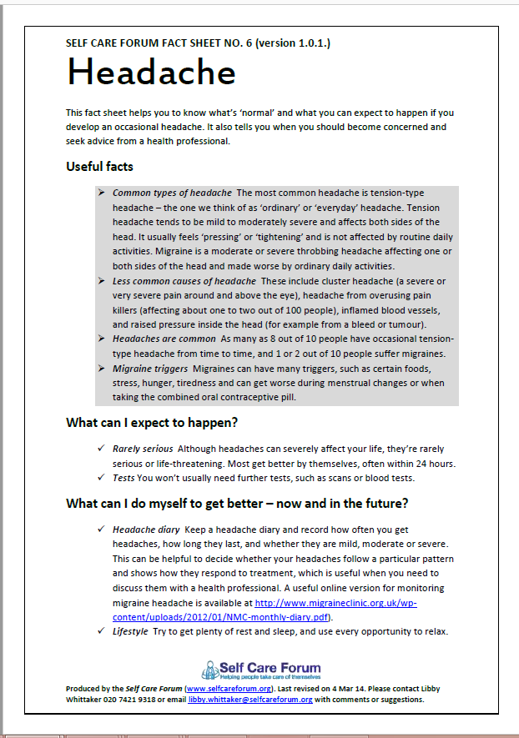
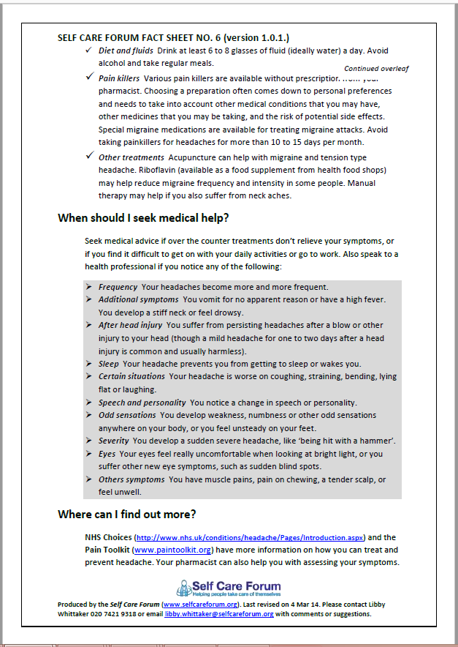
Reliable info: SCF Fact Sheets
1. Low Back Pain
2. Eczema
3. Heartburn and indigestion
4. Fever in children
5. Constipation
6. Headache and migraine
7. Coughs
8. Acne
9. Sprains and strains
10. Sore throat
11. Otitis media
12. Common cold
13. Sinusitis
14. Urine symptoms in men

Slide 33
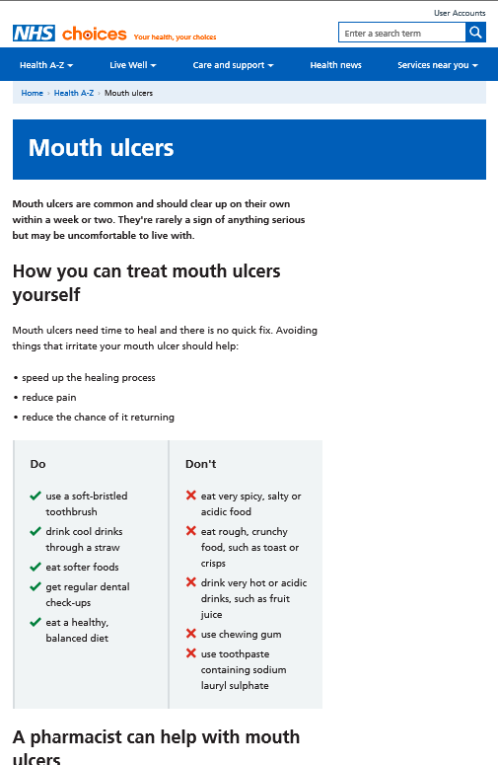
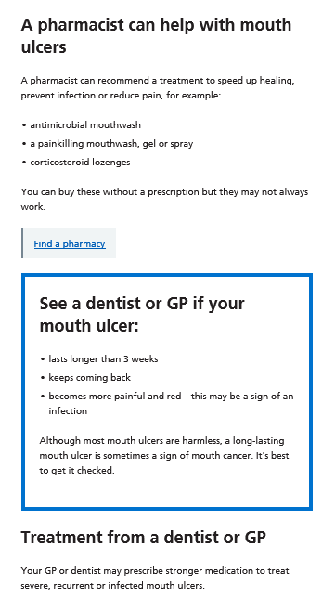
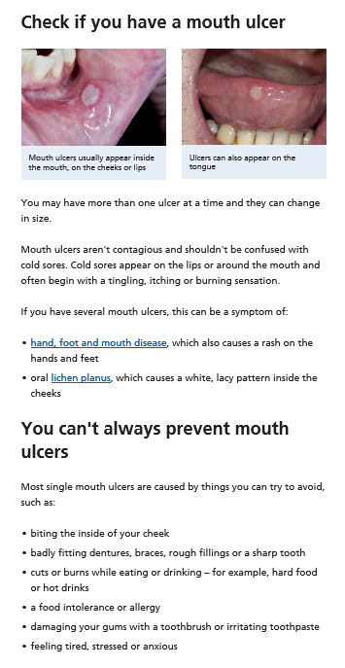
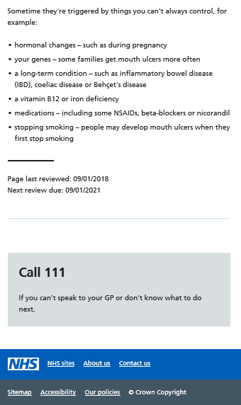
www.NHS.uk

Slide 34
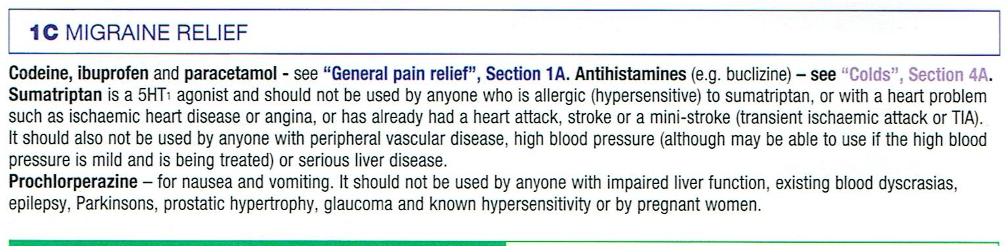
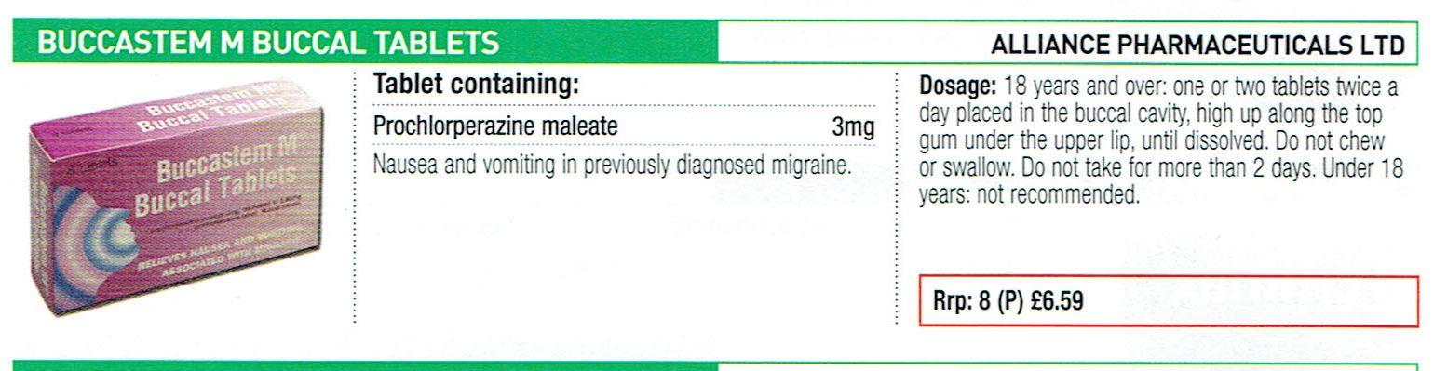
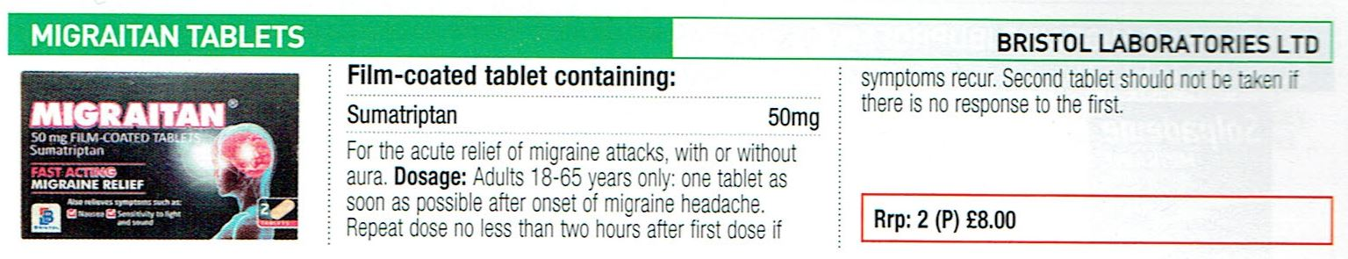
PAGB OTC Directory

Slide 35
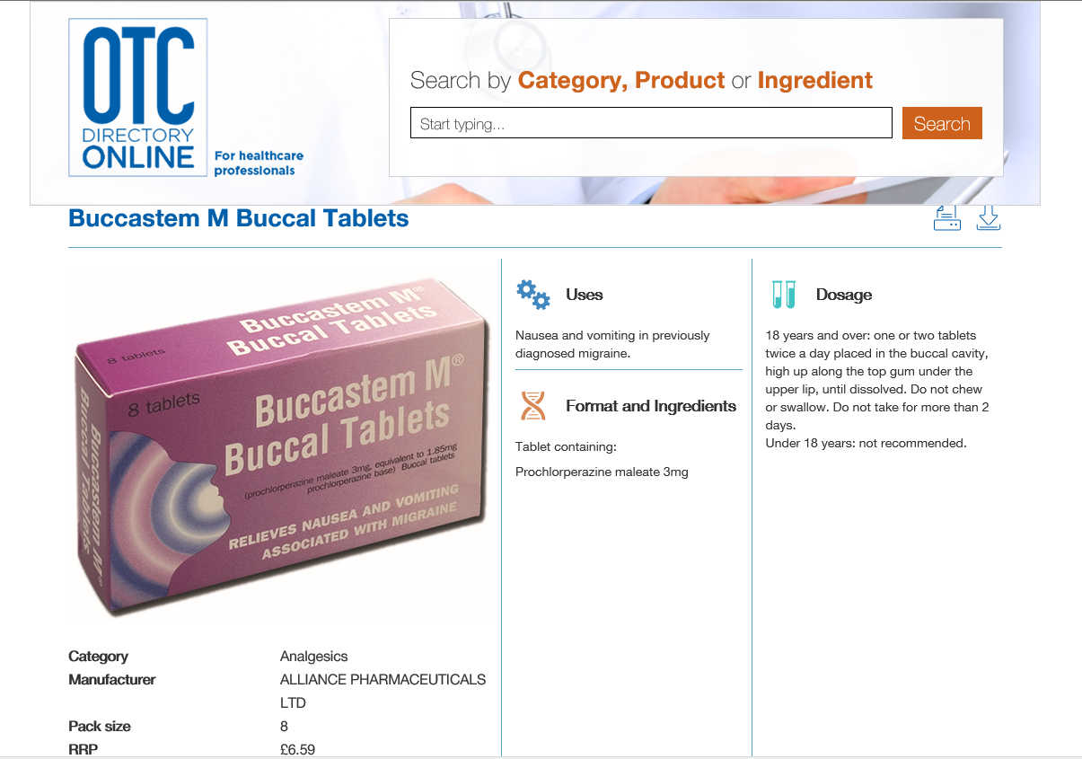
Online directory

Slide 36
www.selfcareforum.org
Case studies, practical advice, toolkits
Award winners
Presentations
Evidence
Fact Sheets
Exemplar approaches to marketing, engagement at all levels
  Practices
  CCGs
  Local authority

