Slide 1
Acute Kidney Injury: Prevention, detection and follow-up in Primary Care
April 2017

Slide 2
Introduction
Why focus on AKI?
Recognised as patient safety priority by NHS England
Up to 100,000 deaths a year in hospital are associated with AKI
~1 in 5 people admitted to hospital as an emergency have AKI
Estimated that up to 30% of cases preventable
~65% of AKI cases start in the community
Ref: Think Kidneys National AKI Programme https://www.thinkkidneys.nhs.uk/aki/wp-content/uploads/sites/2/2017/02/NHS-Think-Kidneys-AKI-Programme-Review-and-Evaluation.pdf

Slide 4
Aetiology (1)
Many different underlying causes - three AKI categories:¹
1. Prerenal AKI
Most cases in community are prerenal - interruption to perfusion of kidneys
Causes:
- Hypovolaemia/volume depletion: haemorrhage, GI loss (diarrhoea, vomiting), sweating, burns, renal loss (diuretic overdose, osmotic diuresis [e.g. diabetic ketoacidosis])
- Intrarenal vasoconstriction (haemodynamically-mediated): effects of NSAIDs, ACEIs/ARBs, heart failure, liver failure, hypercalcemia
Systemic vasodilation: sepsis, neurogenic shock
1. Rahman et al. Am Fam Physician. 2012:86:631-9

Slide 5
Aetiology (2)
2. Renal/intrinsic AKI
Direct effects on different sites in kidney:
Glomerular: glomerulonephritis
Interstitial: drugs with nephrotoxic potential (penicillin analogues, cephalosporins, sulphonamides, ciprofloxacin, acyclovir, rifampin, phenytoin, PPIs, NSAIDs); infections, viruses
Vascular: renal vein thrombosis; renal atheroembolic disease; renal infarction
Tubular: prolonged hypotension; nephrotoxicity:
exogenous nephrotoxic agents - radiographic contrast agents, aminoglycosides, methotrexate
endogenous nephrotoxins: rhabdomyolysis, hemolysis, tumor lysis syndrome, myeloma )

Slide 6
Aetiology (3)
3. Post-renal AKI:
5-10% AKI cases due to obstruction of urine flow
Causes:
- renal stones
- crystals (poorly soluble drugs)
- tumours
- enlarged prostate
- bladder, prostate or cervical carcinoma

Slide 7
Most Common Causes of AKI
Medication
Vomiting/diarrhoea
Diuretic overuse
Sepsis
Kidney stones
Prolonged hypotension
Radiographic contrast agents
Diabetic Ketoacidosis
A combination (e.g medication exacerbated by vomiting/diarrhoea)

Slide 8
Assessments if AKI present
Assessment of volume status – temp; peripheral perfusion; heart rate/BP; jugular venous pressure; moistness of mucous membrane; skin turgor
Renal function and serum potassium levels.
To help identify possible causes, ask questions about:
current symptoms: unwell? (diarrhoea, vomiting, breathlessness)
recent symptoms for obstructive cause? (lower urinary tract symptoms, bloating from a pelvic mass, renal colic)
drug history (including OTC, recreational drugs and herbal remedies)
social history (tropical diseases [e.g. malaria], exposure to rodents [e.g. leptospirosis, hantavirus]
Assess for renal disease by performing urine dipstick testing.
Protein 3+/4+ suggest intrinsic glomerular disease; haematuria in presence of proteinuria suggests glomerular cause
Haematuria may suggest lower urinary tract disease in association with tumours, calculi, infection, or severe renal ischaemia due to arterial or venous thrombosis.
Increased white cells non-specific but may suggest infection (most common) or acute interstitial nephritis. Nitrites plus white cells may be due to pyelonephritis.
Be aware that dipstick analysis of urine from people with catheters should be interpreted with caution because of the possibility of false positive results.

Slide 9
Role of primary care in AKI…
Recognition of ‘at risk’ patients’
to help implement prevention strategies, improve chances of early detection
Prompt delivery of interventions to help limit severity of AKI
e.g. prompt response to new Early Warning Alerts (see later slide)
timely provision of medicines ‘sick day’ guidance; provision of supportive advice, e.g. maintaining hydration
awareness of criteria for referral/admission
Delivery of post-AKI follow-up
ongoing monitoring of renal function
medication reviews
limiting risk of further episodes, e.g. self-care advice to patients/carers

Slide 10
Recognising at-risk patients – risk factors (adults) - presence in patients presenting with acute illness should prompt suspicion and creatinine serum testing
CKD (particularly if eGFR <60)
Previous AKI
Chronic conditions (heart failure, liver disease, diabetes)
Sepsis
Hypovolaemia (diarrhoea, vomiting)
65 years or over
Use of nephrotoxic drugs in past week, especially if hypovolaemic (NSAIDs, ACEIs, ARBs, diuretics, aminoglycosides)
Use of iodinated contrast agents within past week
Low urine output (< 0.5 ml/kg/hour)
Limited access to fluids (neurological/cognitive impairment; disability)
Symptoms/history of urological obstruction

Slide 11
Responding to AKI Warning Alerts in Primary Care
Automated delivery of AKI Warning Stage Alerts from pathology labs to practices based on creatinine test results
GP can expect 1 alert every 1-2 months; mostly Stage 1s
‘Positive’ warning indicates ‘possibility’ of AKI; consideration of clinical context is key
Possibility of false positives - e.g. normal increase in creatinine following pregnancy; anticipated drug-related increases)
And false negatives – e.g. occurrence of AKI in the past year could result in spuriously high calculation of patient’s baseline creatinine

Slide 12
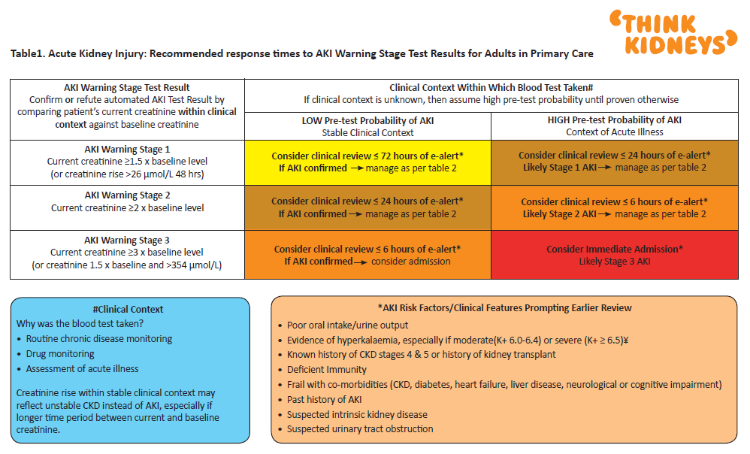
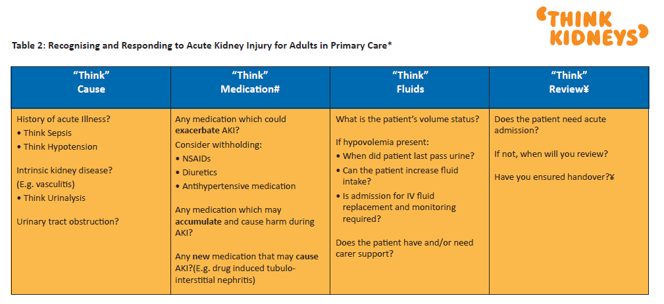
Responding to warning alerts
‘Think Kidney’s has published guidance on responding to these alerts – also includes staging and referral criteria
See Think Kidney’s resource (www.thinkkidneys.nhs.uk/aki/wp-content/uploads/sites/2/2016/10/RespondingtoAKI-Warning-Stage-Test-Results-for-Adults-in-Primary-Care.pdf)

Slide 13
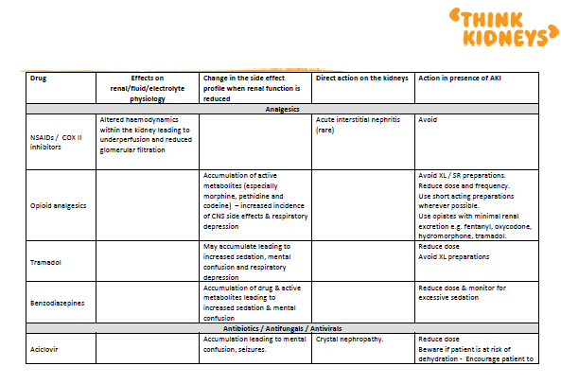
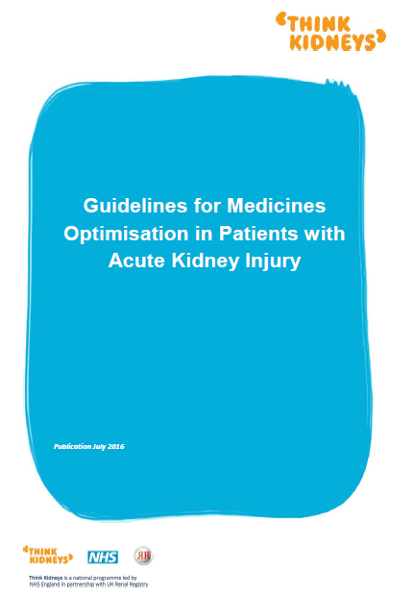
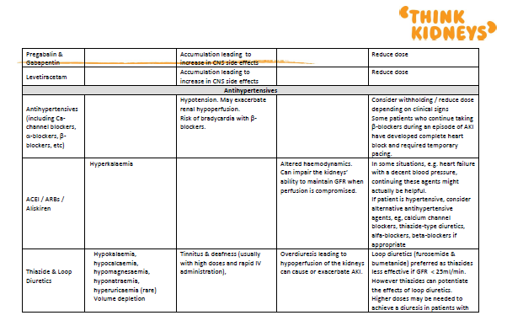
Medicines in AKI
If AKI detected, “Think Medicines”
MO guidance and suggested actions to take for a wide problematic medicines available from Think Kidneys…
See Think Kidney’s website https://www.thinkkidneys.nhs.uk/aki/wp-content/uploads/sites/2/2016/03/Guidelines-for-Medicines-optimisation-in-patients-with-AKI-final.pdf

Slide 14
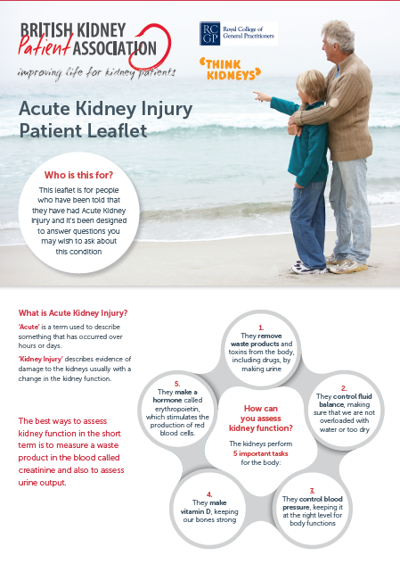
Other AKI resources ….
‘Think Kidneys’ website (www.thinkkidneys.nhs.uk) has lots more resources for…..
Primary care: www.thinkkidneys.nhs.uk/aki/resources/primary-care/
Care homes: https://www.thinkkidneys.nhs.uk/aki/resources/care-homes
Patients: range of leaflets available at https://www.thinkkidneys.nhs.uk/aki/resources/primary-care/

Slide 15
Workshop Questions
AKI is usually caused by an acute insult on top of background morbidity. What are the top 5 background morbidity risk factors and top 3 acute insults.
If a patient presents with these risk factors and AKI is suspected what do you do?
Identify High Risk medicines in Patients where AKI is suspected
For each medicine what action would you take
If the patient is admitted to hospital with AKI what actions should be taken when the patient is discharged
If any high risk medicines were stopped what action should be taken post AKI
What key pieces of information would you put in a patient information leaflet about AKI

Slide 16
From London AKI Network Algorithm

Slide 17
Selected high-risk medicines - suggested actions to take in presence of AKI¹
NSAIDs/COX II inhibitors: Avoid use
Aminoglycosides: Avoid use if possible. If unavoidable, reduce dose &/or increase dosing interval. Monitor drug levels and renal function 2-3 times/week
Trimethoprim: Avoid or reduce dose (particularly if patient is already taking an ACEi, ARB or spironolactone – and particularly elderly patients)
Tetracycline: Avoid use
Metformin: Avoid if GFR <30 ml/min
Methotrexate: Avoid esp. if patient at risk of hyperkalaemia
5-aminosalicylates: Avoid use
Tolvaptan ( Vasopressin V₂ receptor antagonist): Stop and seek specialist advice.

Slide 18
Suggested action to take with antihypertensives
Antihypertensives: Consider withholding/reduce dose depending on clinical signs. Some patients who continue taking beta-blockers during an episode of AKI have developed complete heart block and required temporary pacing.
Thiazide & loop diuretics: Monitor and adjust dose as necessary.
Potassium sparing diuretics: Avoid use.
RAS drugs (ACEi/ARBs/aliskiren): Consider withholding.
In some situations, e.g. heart failure with a decent blood pressure, continuing them might actually be helpful.
If patient is hypertensive, consider alternative antihypertensive agents, e.g., calcium channel blockers, thiazide-type diuretics, alpha-blockers, beta-blockers if appropriate.

Slide 19
Post-AKI follow-up in primary care
Been suggested that improvements required in primary care follow-up of patients after hospital stay complicated by AKI
Follow up:
early review to assess renal recovery and review of medications that have may been stopped
longer-term monitoring to development/progression of CKD:
many people may have residual CKD
NICE recommend monitoring renal function for 3 years post-AKI (CG169)
opportunity to provide advice to patients/carers to limit further AKI episodes - e.g. advice on medicines to stop on ‘sick days’; importance of hydration

Slide 20
Post-AKI follow-up in primary care
Example: Recent CCG initiative¹ included development of post-
discharge GP practice action plans. Key processes for plan:
Coding: Has there been appropriate coding of AKI?
Audit of this CCG found 75% of patients with AKI on discharge sheet did not have coding in primary care record.
Medication Review: Has the patient had a medication review within 4 weeks post-discharge?
Monitoring: Has kidney function been checked within 3 months?
Communication: Has AKI risk been communicated to the patient (and carer)?
1.https://www.thinkkidneys.nhs.uk/aki/wp-content/uploads/sites/2/2017/02/Bury-AKI-Think-Kidneys-Case-Study.pdf

Slide 21
Restarting drugs after an AKI episode
ACEIs, ARBs, diuretics commonly stopped during AKI. Think Kidneys resource on restarting¹ – selected points:
Review original indication for use of the drug - if specific contraindication, use alternative
Heart failure patients:
re-start ACEI/ARBs as soon as clinically reasonable
re-titration (by either GP or heart failure service, if patients under service)
CKD with albuminuria:
restart ACEI/ARBs unless new contra-indication (e.g. serum potassium >5 mmol/L)
1. https://www.thinkkidneys.nhs.uk/aki/wp-content/uploads/sites/2/2016/02/When-to-restart-drugs-stopped-during-AKI-final.pdf

Slide 22
Restarting drugs after an AKI episode
Patients with Hypertension:¹
Review antihypertensive strategy and re-check BP - ideally ambulatory
Bring prescribing into line with NICE CG127, if not already
CCB 1st-line for >55’s and black people of African/AfroCaribbean origin
For other patients, re-start drug unless potassium > 5 mmol/l, or risk of recurrent hypovolaemia, in which case consider alternatives
Re-measure creatinine and potassium 1-2 weeks after starting and after any dose titration
If patient left off treatment (e.g. clinic BP <140/90; home BP <130/85), further follow up should be offered for at least 12 months, as BP may take time to return to previous levels
1. https://www.thinkkidneys.nhs.uk/aki/wp-content/uploads/sites/2/2016/02/When-to-restart-drugs-stopped-during-AKI-final.pdf

Slide 23
Other AKI resources ….
‘Think Kidneys’ website (www.thinkkidneys.nhs.uk) has lots more resources for…..
Primary care: www.thinkkidneys.nhs.uk/aki/resources/primary-care/
Care homes: https://www.thinkkidneys.nhs.uk/aki/resources/care-homes
Patients: range of leaflets available at https://www.thinkkidneys.nhs.uk/aki/resources/primary-care/

