Slide 1
Acute Kidney Injury
Clair Huckerby
Pharmaceutical Public Health Team
Dudley CCG

Slide 2
Our missions
To improve the health and wellbeing of the population of Dudley, reduce health inequalities and increase healthy life expectancy through the safe and effective use of medicines and pharmacy services.
To make Dudley the safest place to take medicines in the UK.

Slide 3
Acute Kidney Injury – National impact
AKI seen in 13-18% of all people admitted to hospital
100,000 deaths p.a. in hospital attributed to AKI
1% of the NHS budget (£1.02 billion)
Under recorded and under-recognised
Coding is an issue
30% of AKI cases are preventable
Average cost of an AKI admission is £2,350 (exc. ITU)

Slide 4
Acute Kidney Injury – National impact
Risk assessment, prevention, early recognition and management are key factors in preventing deaths and reducing complications
NICE Quality Standards relevant to Primary Care:
1. Discuss the causes of AKI with those who are at risk
2. AKI risk assessment

Slide 5
AKI in Dudley

Slide 6
AKI in Dudley

Slide 7
How did we compare to other areas? (2015)

Slide 8
Acute Kidney Injury in Dudley February 2015
Estimated UK incidence of AKI is 486-630 per million people per year (www.renal.org)
Estimated Dudley annual incidence = 486+630/2x.314 = 175 people per year
Estimated number of admissions coded as AKI per year(based on 2014/15 April – November data ) = 83
Under-reporting suspected and confirmed
Commenced RCA reviews of available AKI admissions data
Learned that only the primary reason for admission was captured
17 confirmed AKI admissions cost in excess of £40,000
estimated cost of AKI admissions for Dudley is at least £1,335,000
NPSA alert- standardising the early identification of AKI published June 2014 to be fully implemented by Trusts by March 2015

Slide 9
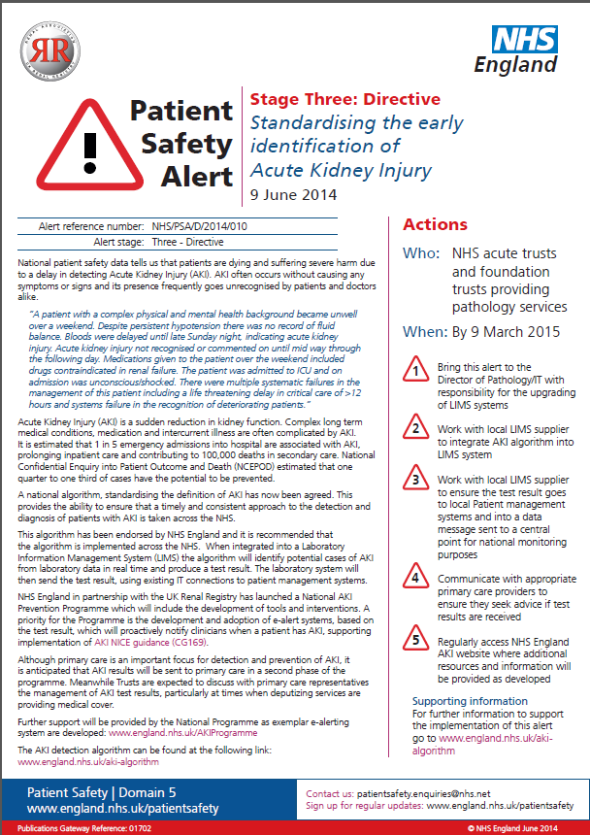

Slide 10
Initial findings from HARMS project
Quarter | Number of confirmed AKI HARMS | Reasons for AKI | Suggested action
1 2014/15 | 6 | Diuresis whilst poor fluid intake Lack of regular monitoring Lack of monitoring post initiation of diuretics and ACEI | Educate patients to manage fluid intake when prescribed diuretics Prompt monitoring when initiated on diuretics and ACEI
2 2014/15 | 4 | 3 x above 1 x due to analgesia (NSAID) | Monitoring of renal function before and during NSAID use ? Consider shorter term NSAID use
3 2014/15 | 9 | 8 x above 1 x due to analgesia (NSAID) | Community phlebotomy access issues to be addressed Utilisation of EMIS WEB functions
4 2014/15 | 7 | 7 x above | Implementation of sick day guidance
1 2015/16 | 8 | 8 x above | Risk assessment to flag those at high risk due to polypharmacy PPIs and risks of hyponatraemia raised

Slide 11
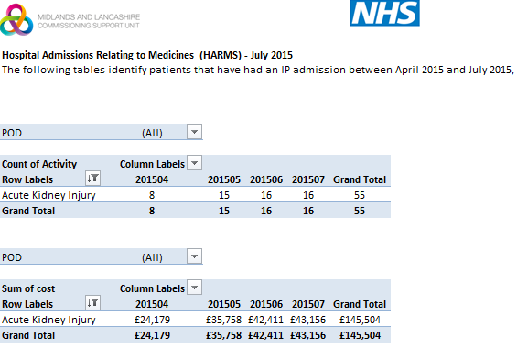

Slide 12
Local data
Local HARMS data from the CSU didn’t seem accurate
Process for notifying primary care when admission involved with AKI discussed with consultant biochemist
Were AKI admissions/ incidences getting reported to the renal registry?
Recommended Minimum Requirements of a Care Bundle for Patients with AKI in Hospital- discussed with consultant biochemist to understand local picture
Data issue raised with CSU who then started to produce data with AKI in any diagnosis order leading to an increase in reported activity from 40 to 403 cases in the same period!
We now have around 600 admissions a year which is congruent with Renal Registry data

Slide 13
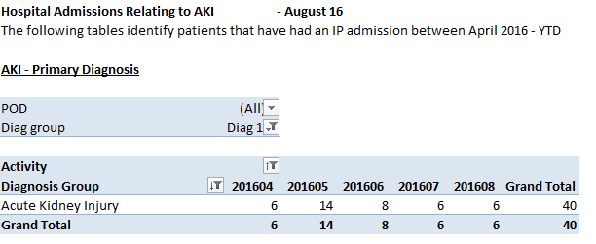

Slide 14
August 2016
Stage 2 NPSA alert: raise awareness and support clinicians for signposting
Think Kidneys programme
www.thinkkidneys.nhs.uk/aki/think-kidney-publications/

Slide 15
Acute Kidney Injury in Dudley February 2016
Around 600 admissions AKI pa. – HES data
DGH implemented NPSA alert (June 2014) and minimum care bundle
Med review and RCA to establish if a HARM
Approx. 47,000 on ACEIs, ARBs, diuretics
Approx. 16,000 > 75 years
Designed suite of interventions
Providing tools to PBP team to deliver patient benefit
Long term project

Slide 16
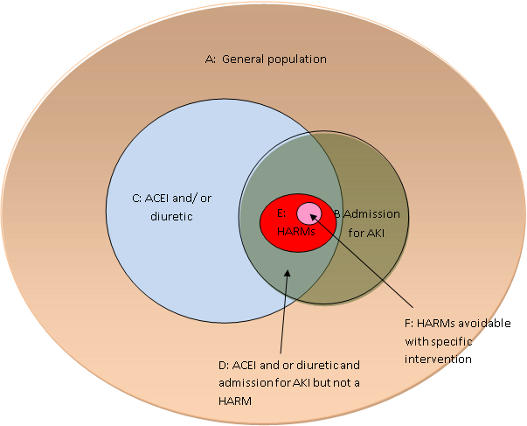
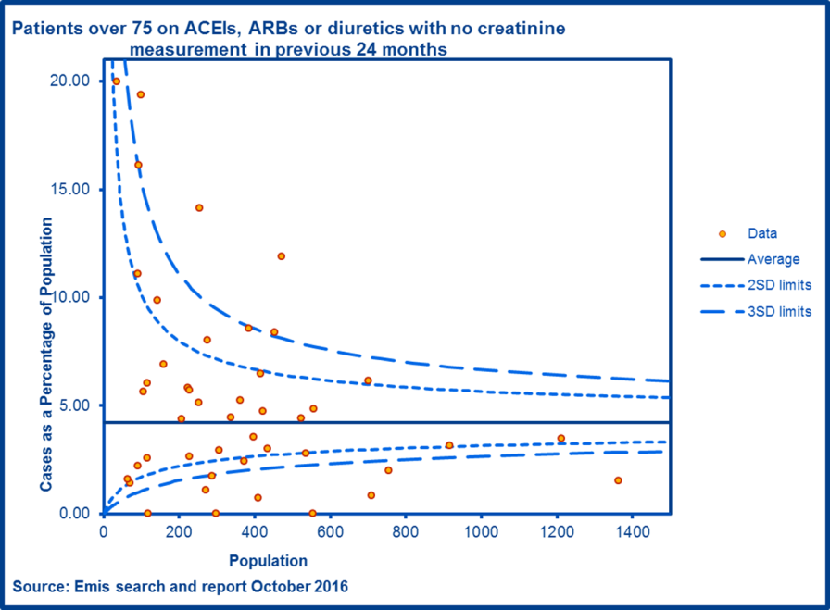
Systematic, population-based and data-driven

Slide 17
Project plan
Elements of project plan:
UTI audit
Targeted medication review,
sick day guidance
Clinician education
Resources:
Patients who have had an AKI: https://www.thinkkidneys.nhs.uk/aki/resources/primary-care/
Patients at risk leaflet:
https://www.thinkkidneys.nhs.uk/aki/resources/primary-care/

Slide 18
UTI audit
Baseline audit –prescribing for UTIs in over 65’s December 2016
CCG wide
Follow up audit March 2017
To focus on the hydration status of individuals prior to prescribing for UTI

Slide 19
Medication Review
Use of EMIS Search and Report
Practice level reporting and review
a)CKD4 + previous AKI
b)CKD3 + significant proteinuria (ACR>30)
c) Patients prescribed ACE/ARB/Diuretic without renal monitoring (creatinine) in the last 36 months for all patients and also for patients aged 75 years and over.
Use of Think kidneys resources at Medication Review- medicines optimisation toolkit: https://www.thinkkidneys.nhs.uk/aki/medicines-optimisation-for-aki/

Slide 20
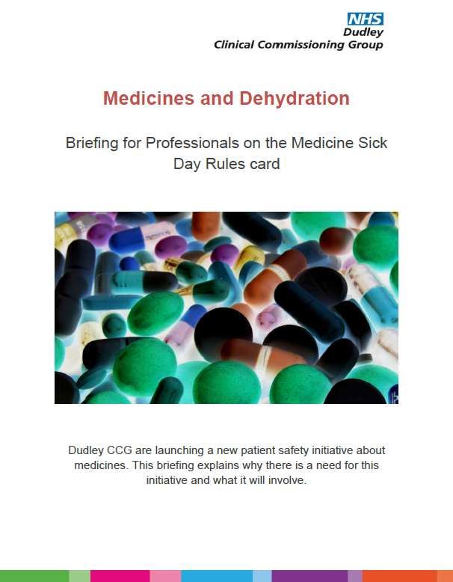
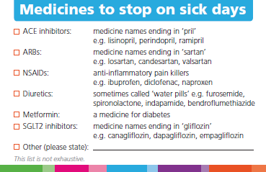
Sick Day Guidance

Slide 21
Education
GP education session delivered Feb 2016
Care Homes Education programme – nutrition and hydration guide
Think Kidneys Care Homes Pilot Project: https://www.thinkkidneys.nhs.uk/aki/resources/care-homes/
Launch of EMIS template for AKI January 2017
AKI app for clinician use shared amongst all clinicians
Prescribing newsletter dedicated to AKI (Dec 2016)
PBP Team on-going training- CPPE, bespoke training events
An RCGP Learning e-module on AKI developed in collaboration with the think Kidneys programme is available here: http://elearning.rcgp.org.uk/course/info.php?id=213

Slide 22
What can we do in Primary Care?
Many people who develop acute kidney injury are not aware of the potential causes and how to prevent it.
AKI can be prevented by educating those at risk : a discussion with a health professional and parents or carers.
Better education of healthcare professionals delivered in primary care and outpatient settings in addition to on discharge from hospital will help to reduce the number of people developing AKI outside hospital and the number being admitted to hospital with the condition.

Slide 23
References:
NCEPOD. Adding insult to injury, 2009
Wang, et al. 2012
Selby, et al. 2012
NPSA Safety Alert, Stage 3: Standardising the identification of Acute Kidney Injury. NHS Improvement; NHS/PSA/D/2014/010. June 2014. https://www.cas.dh.gov.uk/ViewandAcknowledgment/ViewAlert.aspx?AlertID=102171
NPSA Safety Alert, Stage 2: resources to support the care of patients with acute kidney injury. NHS Improvement; NHS/PSA/RE/2016/007. August 2016. https://www.cas.dh.gov.uk/ViewandAcknowledgment/ViewAlert.aspx?AlertID=102518
Acute Kidney Injury. Quality Standard QS76. NICE. Published December 2014.
Medication Review Best Practice Guidelines. http://www.dudleyformulary.nhs.uk/page/20/guidelines

