Slide 1
The Challenges for Medicines Optimisation
Dr Bruce Warner, Deputy Chief Pharmaceutical Officer, NHS England

Slide 2
Medicines have a vital role to play
Medicines:
Prevent life-threatening diseases
Help to change previously life-threatening illnesses to long-term conditions eg HIV
Improve the quality of life for people with long-term conditions
Reduce mortality across a wide range of diseases and thereby helping to increase life expectancy
They are the most common therapeutic intervention and NHS spends £14.4 billion each year on them – 15% of its annual budget.
Notes:
Keith

Slide 3
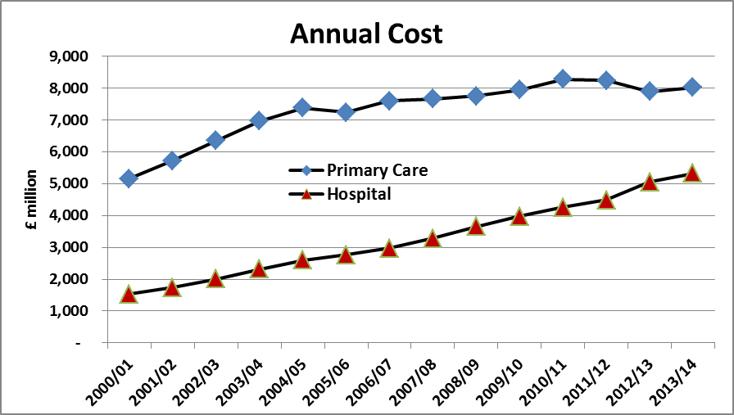
But…
Patients report having insufficient supporting information
Poor adherence: 30 - 50% of medicines not taken as intended
Medicines wastage in primary care: £300M pa with £150M pa avoidable
UK literature suggests 5 to 8% of hospital admissions due to preventable adverse effects of medicines

Slide 4
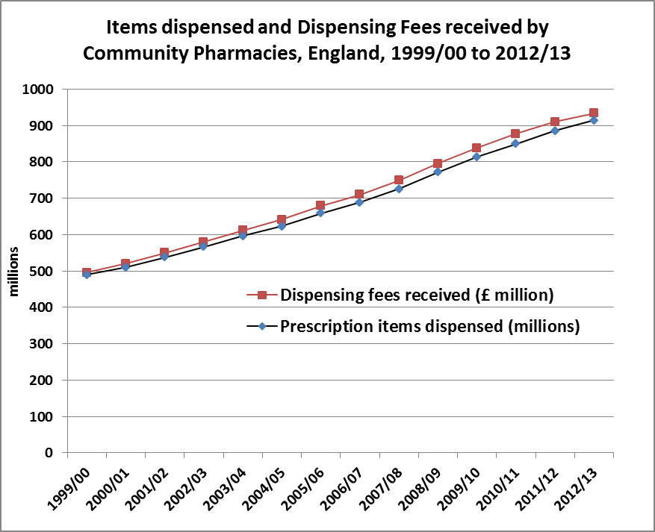
In addition…
Inadequate review and monitoring of medicines outcomes
Polypharmacy
Uptake of newer medicines can be patchy
There is unwarranted variation in use of medicines across England
The threat of antimicrobial resistance
Unacceptable level of medication error

Slide 5
Current challenges facing the NHS
Given the growing demand for medicines that comes with an ageing population and budget constraints, it is more important than ever that the NHS and patients get the best value (in terms of money and outcomes) from our substantial investment in medicines.

Slide 6
Tackling these challenges
We need to help improve patient outcomes, quality and value from (all) medicines use by:
Finding new and innovative ways to deliver services to patients.
Extracting more value from the money spent in the NHS, including from medicines

Slide 7
NHSE and ABPI Medicines Optimisation Programme
NHS England and ABPI are developing a joint programme of work, guided by the Principles of Medicines Optimisation that were published by the Royal Pharmaceutical Society in May 2013.

Slide 8
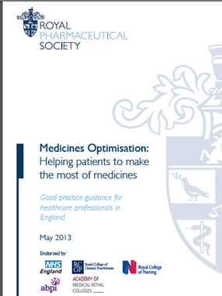
“Medicines Optimisation is about ensuring the right patients, get the right choice of medicine at the right time”
RPS, Medicines Optimisation:
Helping patients to make the most of medicines, May 2013

Slide 9
The goal of Medicines Optimisation
Medicines optimisation looks beyond the cost of medicines to the value they deliver and recognises medicines as an investment in patient outcomes.
The goal of MO is to help patients to:
Improve their outcomes, including better monitoring and metrics
Have access to an evidence-based choice of medicine
Improve adherence and take their medicines correctly
Avoid taking unnecessary medicines
Reduce wastage of medicines
And improve medicines safety

Slide 10
NICE guideline (4th March 2015) – Medicines optimisation
4 March 2015
Medicines optimisation pathway incorporates medicines adherence guideline
Definition used in the guideline: ‘a process that aims to ensure a person-centred approach to safe and effective medicines use, enabling people to obtain the best possible outcomes from their medicines’

Slide 11
NICE guideline (4th March 2015) – Medicines optimisation
Topic areas covered:
Systems for identifying, reporting and learning from medicines-related patient safety incidents
Medicines‑related communication systems when patients move from one care setting to another
Medicines reconciliation
Medication review
Self-management plans
Patient decision aids used in consultations involving medicines
Clinical decision support
Medicines-related models of organisational and cross-sector working

Slide 12
Key principles
Aligns with the RPS principles of medicines optimisation
NICE guideline sets out what needs to be done by all health and social care practitioners and organisations to put in place the person-centred systems and processes required for the optimal use of medicines, including:
involving people in decisions about their medicines
discussing options with the patient (and/or family member or carer)
understanding people’s knowledge, beliefs and concerns about medicines
reviewing people’s medicines when they may be at more risk of medicines-related patient safety incidents, for example, those taking multiple medicines.

Slide 13
Outline work programme
Establishing a patient panel on medicines optimisation
Developing the medicines optimisation dashboard
Developing other metrics further: the innovation scorecard
Specialised commissioning: utilisation of “commissioning through evaluation”
Winning hearts and minds:
Joint NHS England/ABPI “roadshow” through Academic Health Science Networks
Working with senior clinical leaders
Engaging NHS finance professionals
Strategic communications plan

Slide 14
The role of industry and opportunity of PPRS
To address persistent low levels of patient access to modern medicines, industry has agreed to keep growth in the branded medicines bill flat for 2 years and below 2% for a further 3 years
This presents the NHS with a unique opportunity to ensure patients are getting the right medicines at the right time, less constrained by cost
It gives the NHS the flexibility to act based on the full long-term value of medicines rather than using short-term cost containment measures
Notes:
So how does this fit in with the PPRS agreement made between DH and the pharmaceutical industry?
PPRS presents us with a unique opportunity to ensure that patients are getting the right medicines at the right time, less constrained by cost

Slide 15
Assumed and allowed growth rate of branded drugs bill
Branded spend assumed growth and allowed growth rate under PPRS with YOY growth rates (£m), 2013 - 2018
3.1%
NHS branded spend: agreed assumed growth
2.1%
3.9%
3.5%
£m
1.9%
Allowed growth rates under payment scheme
3.9%
1.8%
1.8%
0.0%
0.0%

Slide 16
The payment scheme represents an opportunity to maintain affordable drug spend
Each company pays R% on its annual sales
Branded drugs bill trajectory without cap
Drugs Bill (£m)
9.92%
9.92%
9.92%
Level of branded drugs bill with cap
3.74%
7.13%
Agreed baseline Drugs Bill
2012
2013
2014
2015
2016
2017
2018

Slide 17
Maximising the benefits of PPRS through medicines optimisation
Agreed by Ministerial Industry Strategy Group
Joint programme of action by NHS England and ABPI
Primary aim is to improve patient outcomes, quality and value from (all) medicines use
Guided by the principles of optimisation
Create clinical pull to accelerate uptake of innovative, clinically and cost effective medicines

